Slide 1
Functional Design Patterns for OO Practitioners

Slide 2
Introduction
Our mission
We’ve been thinking about:
How can functional concepts improve our (object-oriented) code?
How can our (object-oriented) brains get a grasp of functional concepts?
We believe that
We should care about functional programming. It is (a part of) the future.
Functional concepts are complementary to OO.
Identifying and using functional patterns is a key to successfully applying FP.

Slide 3
Introduction
Disclaimer
We like to discuss these topics, but there’s not enough time for it today:
OO vs. FP: Which is better?
Java vs. Scala vs. Haskell vs. …: Which is better?
How to make our code even shorter
“pure” FP
The maths behind FP

Slide 4
Introduction
Functional programming in a nutshell
First-class and higher-order functions
Pure functions
Immutability
Lazy evaluation

Slide 5
Introduction
Functional programming in a nutshell
First-class and higher-order functions
Functions are objects, too
Passing functions as arguments to other functions
Examples: List.map/filter/fold
Pure functions
Immutability
Lazy evaluation

Slide 6
Introduction
Functional programming in a nutshell
First-class and higher-order functions
Pure functions
No side-effects
Functions are just transforming parameter values to return values
Referential transparency
Immutability
Lazy evaluation

Slide 7
Introduction
Functional programming in a nutshell
First-class and higher-order functions
Pure functions
Immutability
Data structures cannot be modified after instantiation
Lots of short-lived objects
Lazy evaluation

Slide 8
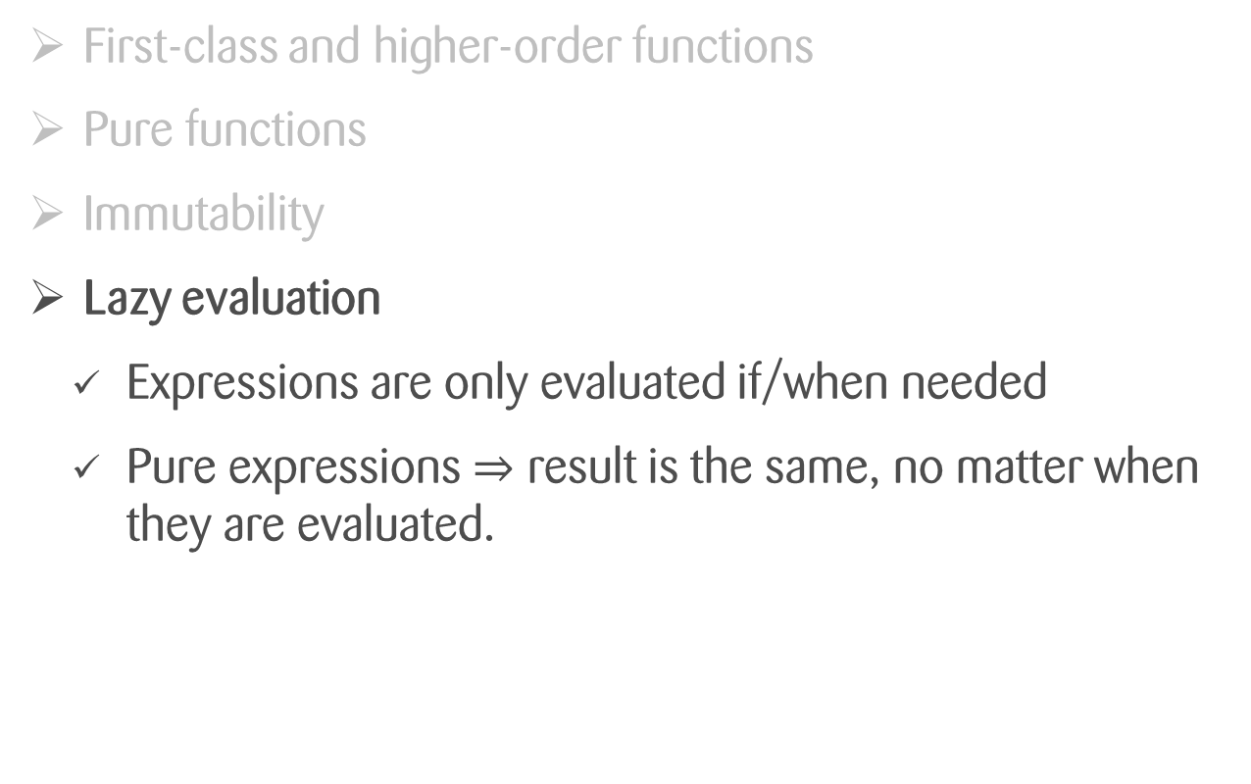
Introduction
Functional programming in a nutshell
First-class and higher-order functions
Pure functions
Immutability
Lazy evaluation
Expressions are only evaluated if/when needed
Pure expressions $⇒$ result is the same, no matter when they are evaluated.
Exceptions?
Termination?

Slide 9
Introduction
Functional patterns
There is no «Gang of 4» in functional programming.
«Functional patterns» is a less concise term.
Focus on composition of functions rather than composition of objects

Slide 10
Introduction
Syntax used in this presentation
=> Scala in 30 seconds

Slide 11
Higher-Order Functions
What? Why? How?
In OO: Like implementing a template method or passing a callback object
Doesn’t this inevitably lead to a mess? Welcome to callback hell!
Avoid it by using well-known patterns: generic h-o functions which do useful stuff with a lot of types.
Use pure (side-effect free) functions

Slide 12
Higher-Order Functions
Examples
map ^{Scala, Java, Haskell}/collect ^{Groovy}:
List(1,2,3).map(x => f(x)) == List(f(1), f(2), f(3))
fold^{Scala, Java, Haskell}/reduce^{Groovy}
List(1,2,3).fold(zero, (acc, x) => f(acc, x)) == f(f(f(zero,1), 2), 3)
filter/findAll
List(1,2,3).filter(x => x > 1) == List(2,3)
flatMap/collectMany
List(10,20,30).flatMap(x => List(x+1,x+2)) == List(11,12,21,22,31,32)

Slide 13
Higher-Order Functions
Example Application
Shopping Cart Total
Load cart items
Get prices of each item (map)
Compute the sum (fold/reduce)
Suggestions
Load items similar to shopping cart items
Remove items with lower rating (filter)
Combine results (flatMap)

Slide 14
Higher-Order Functions
Container Types
Wrap another type and
add some functionality related to the wrapped type
Examples
Collection[T]: combines multiple values of the wrapped type
Option[T]: represents a collection of 0 or 1 value
Future[T]: provides asynchronous computation of a value

Slide 15
Higher-Order Functions
Using them with Container Types
Example: map and flatMap

Slide 16
Load user from database
Def loadUser(id: Int): Try[User] = {…}
loadUser(1000)
> res0: Try[User] = Success(User(1000))
loadUser(1001)
> res1: Try[User] = Failure(Exception(«user not found»))

Slide 17
The Try Type
Represents the evaluation of a value, which may fail
Used instead of throwing exceptions
Def loadUser(id: Int): Try[User]
loadUser(1000)
> res0: Try[User] = Success(User(1000))
loadUser(1001)
> res1: Try[User] = Failure(Exception(«user not found»))

Slide 18
The Option/Optional/Maybe Type
Collection of 0 or 1 value
Used instead of null
Def loadUser(id: Int): Option[User]
loadUser(1000)
> res0: Option[User] = Some(User(1000))
loadUser(1001)
> res1: Option[User] = None

Slide 19
Outcomes
How to avoid side effects, how to write pure code
Immutability
A basic set of higher-order functions is enough to build most of what you need. Everything else is built by composition
Not everything we showed is possible in Java/other OO languages. Sometimes it’s possible to emulate it, sometimes there are libraries that do this

